Slide 1
VLSI DESIGN
Lecture 5
B.E (ECE) 5th semester

Slide 2
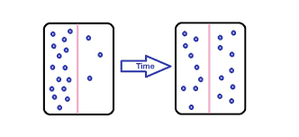
Diffusion
The net passive movement of molecules (or particles) from the region of high concentration to the region of low concentration is called diffusion.
A passive process means no energy is required.
In VLSI, this technique is used to introduce impurity atoms (dopants) into silicon to change its resistivity.

Slide 3
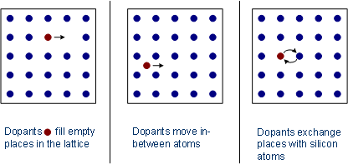
Diffusion is the process of introducing controlled amount of dopants into the semiconductors.
Impurity atoms are introduced onto the surface of a silicon wafer and diffuse into the lattice because of their tendency to move from regions of high to low concentration.
Diffusion of impurity atoms into silicon crystal takes place only at elevated temperature, typically 900 to 1100°C.
At room temperature the diffusion process will be so extremely slow such that the impurities can be considered to be essentially frozen in place.

Slide 4
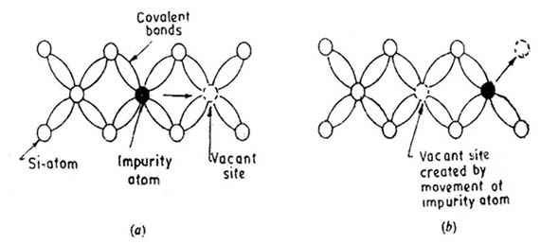
The diffusion of impurities into a solid is basically the same type of process as occurs when excess carriers are created non-uniformly in a semiconductor which cause carrier gradient.
In each case, the diffusion is a result of random motion, and particles diffuse in the direction of decreasing concentration gradient.
The random motion of impurity atoms in a solid is, of course, rather limited unless the temperature is high.
Thus diffusion of doping impurities into silicon is accomplished at high temperature as stated above.

Slide 5
Physical Mechanisms
There are mainly two types of physical mechanisms by which the impurities diffuse into the lattice:
Substitutional diffusion
Interstitial diffusion
Substitutional and Interstitial defects
In Interstitial defect, atom occupies the interstitial space of the lattice structure of solid crystal. Interstitial defect may occur by the atoms of either same solid (called self-interstitial) or foreign material.
In Substitutional defect, the foreign atom occupies only the lattice site of a crystalline solid.

Slide 6
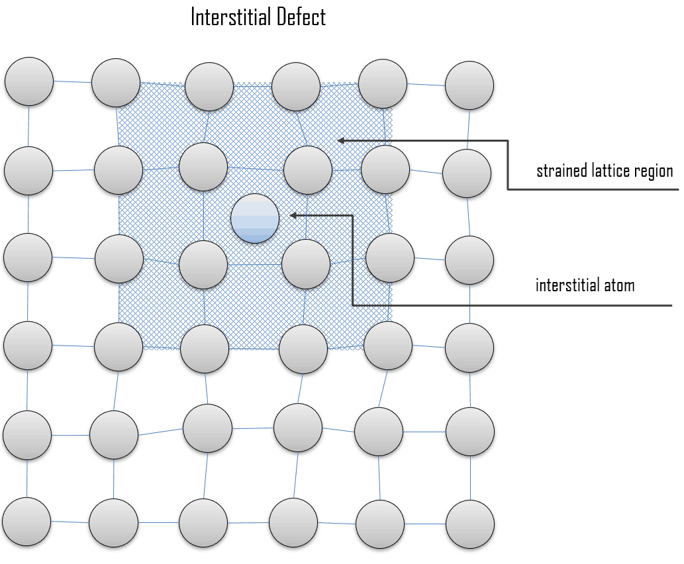
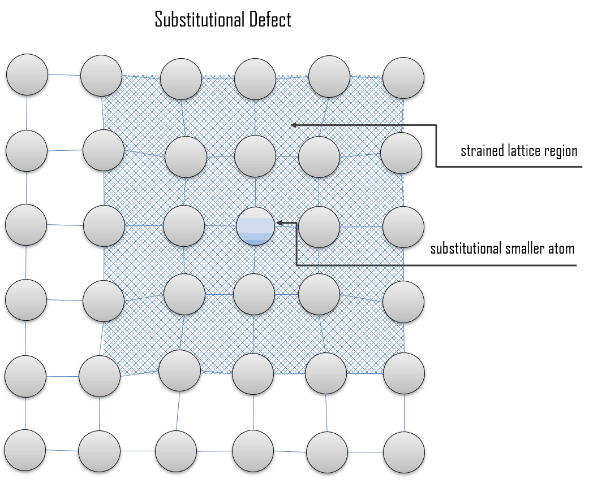
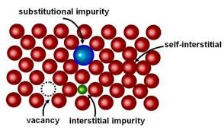

Slide 7
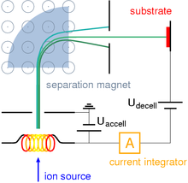
Ion Implantation
Ion Implantation is alternative technique for selective doping of semiconductors. The doping profile is more precisely controlled by this technique.
Ion implantation is a low-temperature process by which ions of one element are accelerated into a solid target, thereby changing the physical, chemical, or electrical properties of the target.

Slide 8
Process:
It is defined as the process by which impurity ions are accelerated to high velocity and physically lodged into the target material.
It is a process by which energetic impurity atoms can be introduced into a single crystal substrate in order to change its electronic properties.
Dopant atoms are vapourized , accelerated , and directed at silicon substrate.
They enter the crystal lattice , collide with silicon atoms , and gradually loose energy , finally coming to rest at some depth within the lattice.

Slide 9
The gas containing the desired impurity is ionized within the ion source.
The ions are generated and repelled from their source in a diverging beam that is focused by the 1st electrical lens before it passes through a mass separator.
The 2nd electrical lens focuses this resolved beam which then passes through an accelerator.
Accelerator brings the ions to their required energy before they strike the target and become implanted in the exposed areas of the silicon wafers.

Slide 10
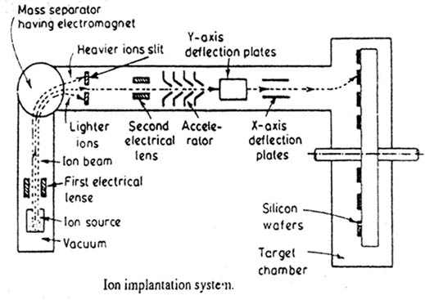

Slide 11
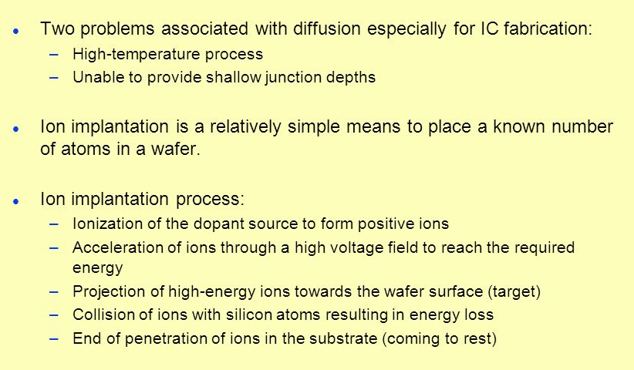
Diffusion vs. Ion Implantation

Slide 12
Questions for you...
What are the advantages and disadvantages of Ion Implantation technique?
Compare the doping profile of dopants added through Ion Implantation and Diffusion techniques.
What is dry etching and wet etching?
Explain ion channelling.

